Slide 1
Chapter # 02, Basic Structures:
Sets, Functions, Sequences, Sums, and Matrices
A set is an unordered collection of distinct objects, called elements or members of the set. A set is said to contain its elements. We write a ∈ A to denote that a is an element of the set A. The notation a ∉ A denotes that a is not an element of the set A.
The set V of all vowels in the English alphabet can be written as V = {a, e, i, o, u}
The set O of odd positive integers less than 10 can be expressed by O = {1, 3, 5, 7, 9}.
The set of positive integers less than 100 can be denoted by {1, 2, 3, … , 99}
FREE: For Complete Playlist: https://www.youtube.com/c/FahadHussaintutorial/playlists
For Code, Slide and Books: https://fahadhussaincs.blogspot.com/

Slide 2
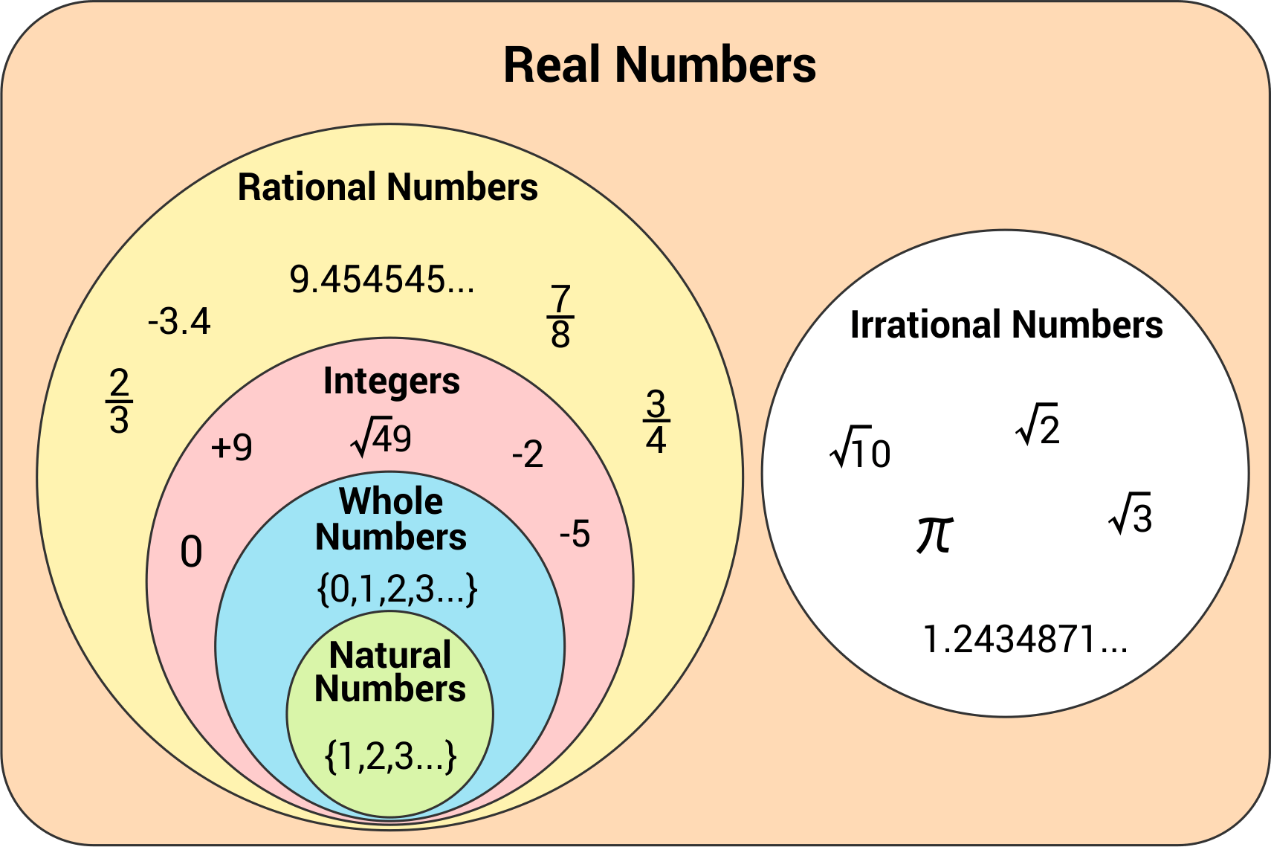
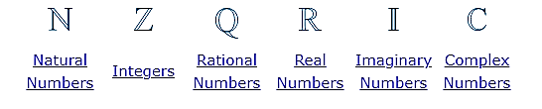
Chapter # 02, Basic Structures:
Sets, Functions, Sequences, Sums, and Matrices
FREE: For Complete Playlist: https://www.youtube.com/c/FahadHussaintutorial/playlists
For Code, Slide and Books: https://fahadhussaincs.blogspot.com/

Slide 3
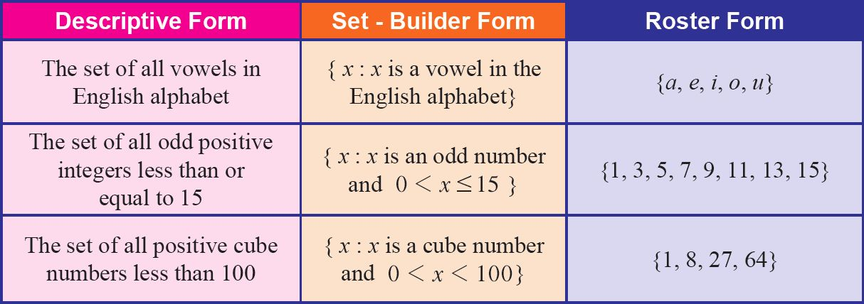
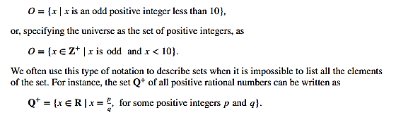
How to describe a set by saying what properties its members have.
FREE: For Complete Playlist: https://www.youtube.com/c/FahadHussaintutorial/playlists
For Code, Slide and Books: https://fahadhussaincs.blogspot.com/

Slide 4
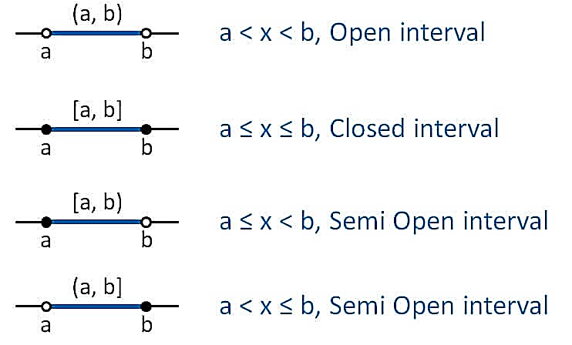
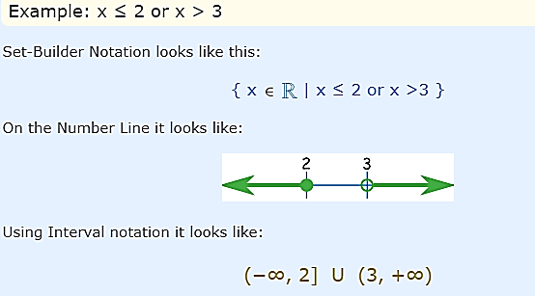
Intervals Notation

Slide 5
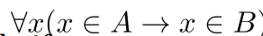
Types of Set
Finite Set
A set which contains a definite number of elements is called a finite set.
Example − S={ x | x∈N and 70>x>50}
Infinite Set
A set which contains infinite number of elements is called an infinite set.
Example − S={ x | x∈N and x>10}
Subset
A set X is a subset of set Y (Written as X⊆Y) if every element of X is an element of set Y.
Example 1 − Let, X={1,2,3,4,5,6} and Y={1,2}.
Here set Y is a subset of set X as all the elements of set Y is in set X. Hence, we can write Y⊆X.
Example 2 − Let, X={1,2,3} and Y={1,2,3}.
Here set Y is a subset (Not a proper subset) of set X as all the elements of set Y is in set X. Hence, we can write Y⊆X.
FREE: For Complete Playlist: https://www.youtube.com/c/FahadHussaintutorial/playlists
For Code, Slide and Books: https://fahadhussaincs.blogspot.com/

Slide 6
Types of Set
Proper Subset
The term “proper subset” can be defined as “subset of but not equal to”.
A Set X is a proper subset of set Y (Written as X⊂Y) if every element of X
is an element of set Y and |X|<|Y|.
Example − Let, X={1,2,3,4,5,6} and Y={1,2}. Here set Y⊂X since all elements in Y are contained in X too and X has at least one element is more than set Y.
Universal Set
It is a collection of all elements in a particular context or application. All the sets in that context or application are essentially subsets of this universal set. Universal sets are represented as U.
Example − We may define U as the set of all animals on earth. In this case, set of all mammals is a subset of U, set of all fishes is a subset of U, set of all insects is a subset of U, and so on.
Empty Set or Null Set
An empty set contains no elements. It is denoted by ∅. As the number of elements in an empty set is finite, empty set is a finite set. The cardinality of empty set or null set is zero.
Example − S={x|x∈N and 7<x<8}=∅
FREE: For Complete Playlist: https://www.youtube.com/c/FahadHussaintutorial/playlists
For Code, Slide and Books: https://fahadhussaincs.blogspot.com/

Slide 7
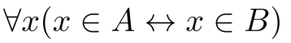
Types of Set
Singleton Set or Unit Set
Singleton set or unit set contains only one element.
A singleton set is denoted by {s}.
Example − S={x|x∈N, 7<x<9} = {8}
Equivalent Set
If the cardinalities of two sets are same, they are called equivalent sets.
Example − If A={1,2,6} and B={16,17,22},
they are equivalent as cardinality of A is equal to the cardinality of B. i.e. |A|=|B|=3
Equal Set
If two sets contain the same elements they are said to be equal.
Example − If A={1,2,6} and B={6,1,2}, they are equal as every element of set A is an element of set B and every element of set B is an element of set A.
FREE: For Complete Playlist: https://www.youtube.com/c/FahadHussaintutorial/playlists
For Code, Slide and Books: https://fahadhussaincs.blogspot.com/

Slide 8
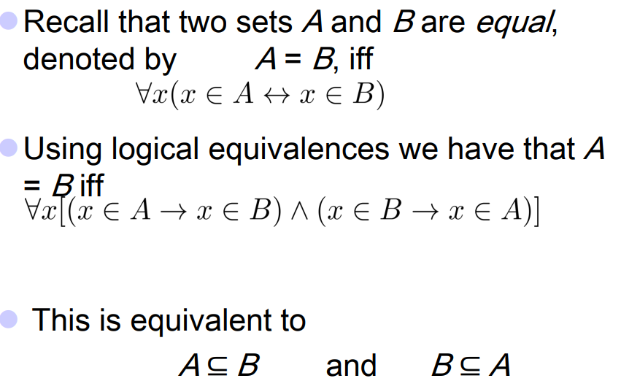
Another look at Equality of Sets
FREE: For Complete Playlist: https://www.youtube.com/c/FahadHussaintutorial/playlists
For Code, Slide and Books: https://fahadhussaincs.blogspot.com/

Slide 9
Types of Set
Overlapping Set
Two sets that have at least one common element are called overlapping sets.
Example − Let, A={1,2,6} and B={6,12,42}.
There is a common element ‘6’, hence these sets are overlapping sets.
Disjoint Set
Two sets A and B are called disjoint sets if they do not have even one element in common. Therefore, disjoint sets have the following properties −
n(A∩B)=∅
n(A∪B)=n(A)+n(B)
Example − Let, A={1,2,6} and B={7,9,14}, there is not a single common element, hence these sets are disjoint sets.
FREE: For Complete Playlist: https://www.youtube.com/c/FahadHussaintutorial/playlists
For Code, Slide and Books: https://fahadhussaincs.blogspot.com/

Slide 10
What is the power set of the set {0, 1, 2}?
Solution: The power set ({0, 1, 2}) is the set of all subsets of {0, 1, 2}.
Hence, Examples ({0, 1, 2}) = {∅, {0}, {1}, {2}, {0, 1}, {0, 2}, {1, 2}, {0, 1, 2}}.
Note that the empty set and the set itself are members of this set of subsets
Cartesian product of A = {1, 2} and B = {a, b, c}?
Solution: The Cartesian product A × B is;
A × B = {(1, a), (1, b), (1, c), (2, a), (2, b), (2, c)}.
The cardinality of a finite set A, denoted by |A|, is the number of (distinct) elements of A.
Examples: 1. |ø| = 0
2. Let S be the letters of the English alphabet. Then |S| = 26
3. |{1,2,3}| = 3
4. |{ø}| = 1
5. The set of integers is infinite.
FREE: For Complete Playlist: https://www.youtube.com/c/FahadHussaintutorial/playlists
For Code, Slide and Books: https://fahadhussaincs.blogspot.com/

Slide 11
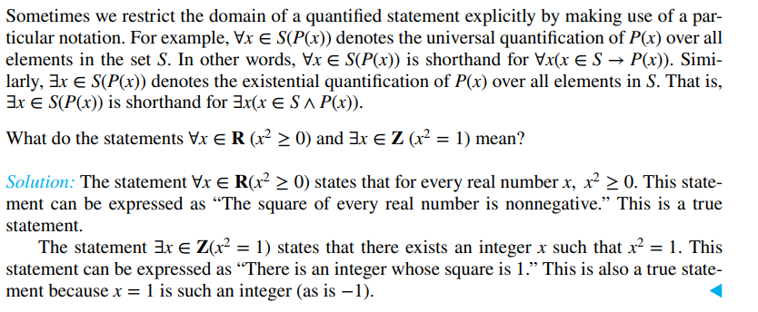
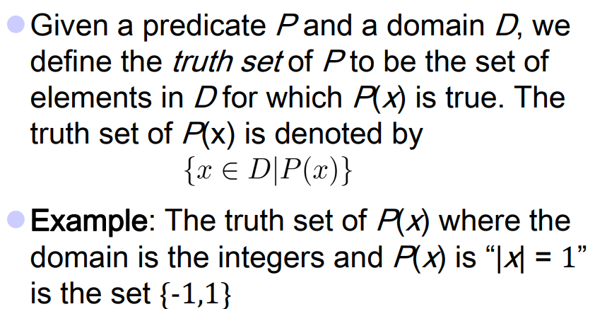
Using Set Notation with Quantifiers
Truth Sets
and
Quantifiers

Slide 12
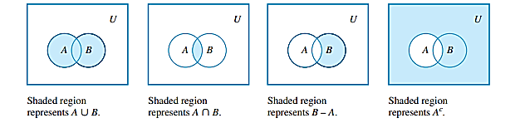
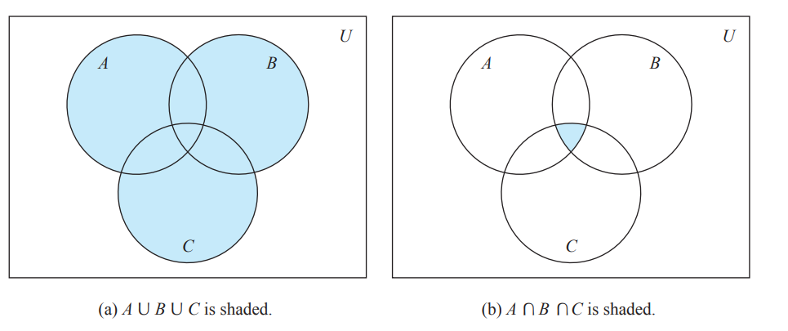
Set Operation
Venn Diagrams
If sets A and B are represented as regions in the plane, relationships between A and B can be represented by pictures, called Venn diagrams, that were introduced by the British mathematician John Venn in 1881.
FREE: For Complete Playlist: https://www.youtube.com/c/FahadHussaintutorial/playlists
For Code, Slide and Books: https://fahadhussaincs.blogspot.com/

Slide 13
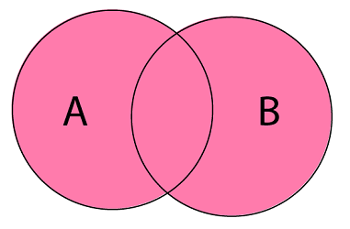
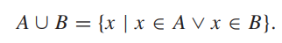
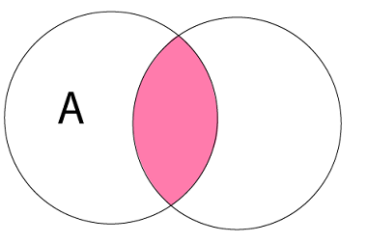
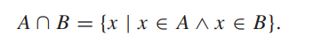
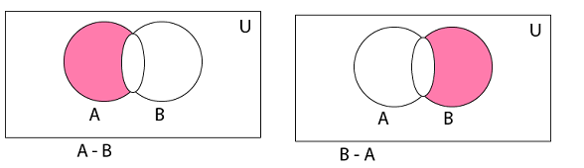
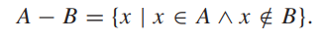
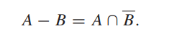
Set Operation
Union of Sets: Union of Sets A and B is defined to be the set of all those elements which belong to A or B or both and is denoted by A∪B.
A∪B = {x: x ∈ A or x ∈ B}
Example: Let A = {1, 2, 3}, B= {3, 4, 5, 6}
A∪B = {1, 2, 3, 4, 5, 6}.
|A ∪ B|=|A|+|B|−|A ∩ B|
Principle of inclusion–exclusion.
Intersection of Sets: Intersection of two sets A and B is the set of all those elements which belong to both A and B and is denoted by A ∩ B.
A ∩ B = {x: x ∈ A and x ∈ B}
Example: Let A = {11, 12, 13}, B = {13, 14, 15}
A ∩ B = {13}.
Difference of Sets: The difference of two sets A and B is a set of all those elements which belongs to A but do not belong to B and is denoted by A - B.
A - B = {x: x ∈ A and x ∉ B}
Example: Let A = {1, 2, 3, 4} and B = {3, 4, 5, 6}
then A - B = {3, 4} and B - A = {5, 6}

Slide 14
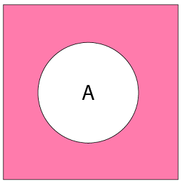
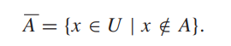
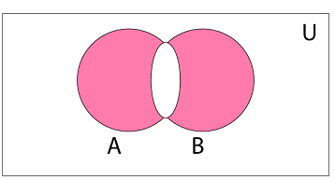
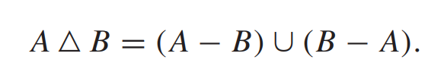
Set Operation
Complement of a Set: The Complement of a Set A is a set of all those elements of the universal set which do not belong to A and is denoted by Ac.
Ac = U - A = {x: x ∈ U and x ∉ A} = {x: x ∉ A}
Example: Let U is the set of all natural numbers.
A = {1, 2, 3}
Ac = {all natural numbers except 1, 2, and 3}.
Symmetric Difference of Sets: The symmetric difference of two sets A and B is the set containing all the elements that are in A or B but not in both and is denoted by A ⨁ B i.e.
A ⨁ B = (A ∪ B) - (A ∩ B)
Example: Let A = {a, b, c, d}
B = {a, b, l, m}
A ⨁ B = {c, d, l, m}
FREE: For Complete Playlist: https://www.youtube.com/c/FahadHussaintutorial/playlists
For Code, Slide and Books: https://fahadhussaincs.blogspot.com/

Slide 15
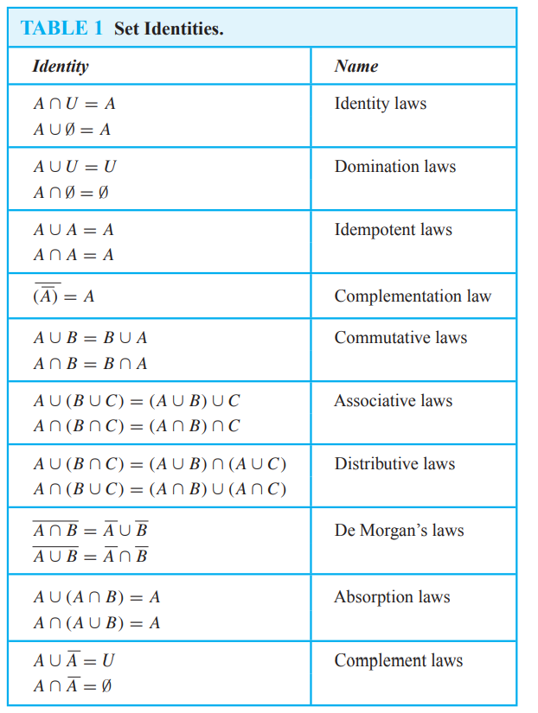
Set Identities
Generalized Unions and Intersections
FREE: For Complete Playlist: https://www.youtube.com/c/FahadHussaintutorial/playlists
For Code, Slide and Books: https://fahadhussaincs.blogspot.com/

Slide 16
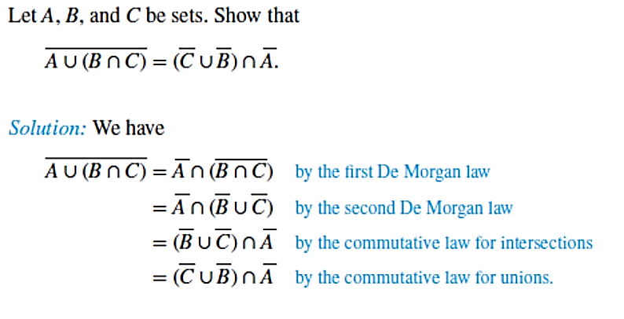
Methods of identity Proof
1. Prove that each set (side of the identity) is a subset of the other.
2. Use set builder notation and propositional logic.
3. Membership Tables: Verify that elements in the same combination of sets always either belong or do not belong to the same side of the identity. Use 1 to indicate it is in the set and a 0 to indicate that it is not.
Proving Set Identities
FREE: For Complete Playlist: https://www.youtube.com/c/FahadHussaintutorial/playlists
For Code, Slide and Books: https://fahadhussaincs.blogspot.com/

Slide 17
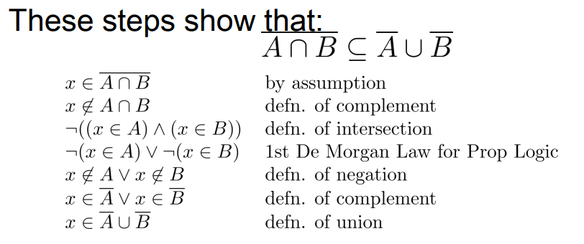
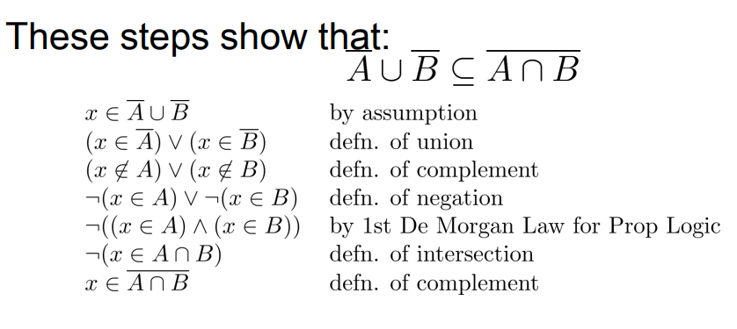
Proof of Second De Morgan Law
FREE: For Complete Playlist: https://www.youtube.com/c/FahadHussaintutorial/playlists
For Code, Slide and Books: https://fahadhussaincs.blogspot.com/

Slide 18
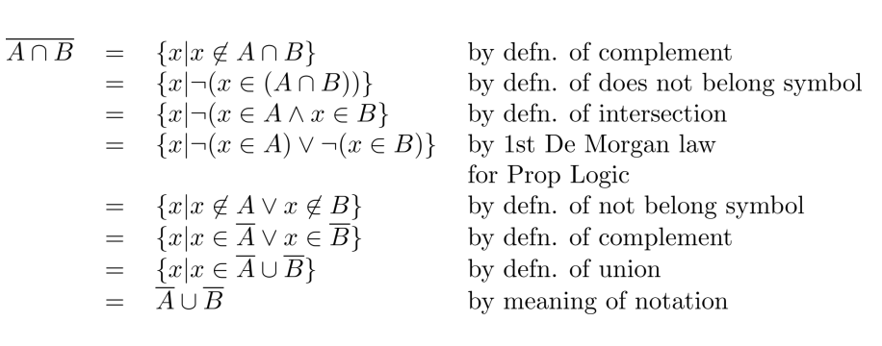
Set-Builder Notation: Second De Morgan Law
FREE: For Complete Playlist: https://www.youtube.com/c/FahadHussaintutorial/playlists
For Code, Slide and Books: https://fahadhussaincs.blogspot.com/

Slide 19
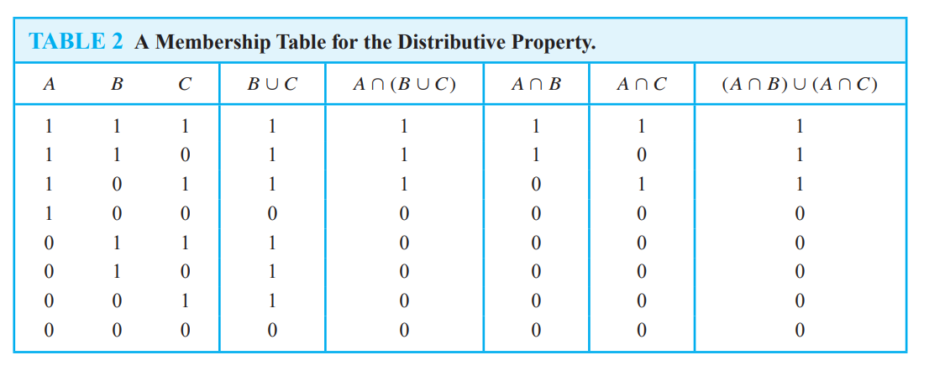
Use a membership table to show that A ∩ (B ∪ C) = (A ∩ B) ∪ (A ∩ C).
FREE: For Complete Playlist: https://www.youtube.com/c/FahadHussaintutorial/playlists
For Code, Slide and Books: https://fahadhussaincs.blogspot.com/

Slide 20
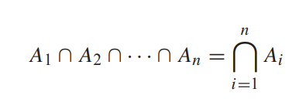
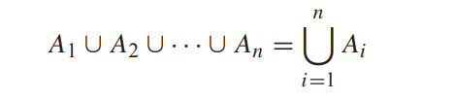
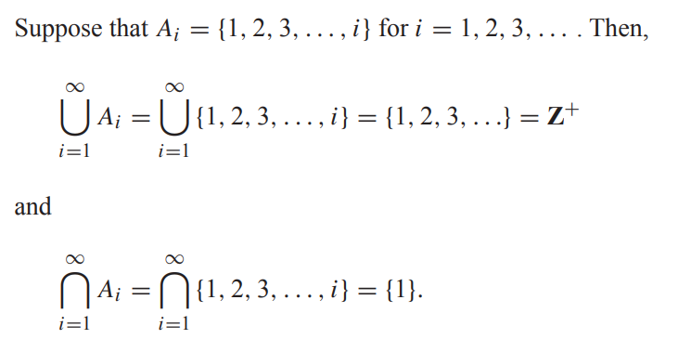
Generalized Unions and Intersections
FREE: For Complete Playlist: https://www.youtube.com/c/FahadHussaintutorial/playlists
For Code, Slide and Books: https://fahadhussaincs.blogspot.com/

Slide 21
Computer Representation of Sets
There are various ways to represent sets using a computer. One method is to store the elements of the set in an unordered fashion. However, if this is done, the operations of computing the union, intersection, or difference of two sets would be time-consuming, because each of these operations would require a large amount of searching for elements. We will present a method for storing elements using an arbitrary ordering of the elements of the universal set. This method of representing sets makes computing combinations of sets easy.
Let U = {1, 2, 3, 4, 5, 6, 7, 8, 9, 10}, and the ordering of elements of U has the elements in increasing order; that is,
ai = i. What bit strings represent the subset of all odd integers in U, the subset of all even integers in U, and the subset of integers not exceeding 5 in U?
The bit string that represents the set of odd integers in U, namely, {1, 3, 5, 7, 9}, has a one bit in the first, third, fifth, seventh, and ninth positions, and a zero elsewhere.
It is 10 1010 1010.
(We have split this bit string of length ten into blocks of length four for easy reading.)
Similarly, we represent the subset of all even integers in U, namely, {2, 4, 6, 8, 10},
by the string 01 0101 0101.
The set of all integers in U that do not exceed 5, namely, {1, 2, 3, 4, 5}, is represented
by the string 11 1110 0000.
FREE: For Complete Playlist: https://www.youtube.com/c/FahadHussaintutorial/playlists
For Code, Slide and Books: https://fahadhussaincs.blogspot.com/

Slide 22
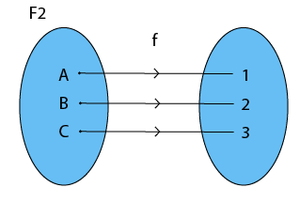
Functions
Definition: Let A and B be nonempty sets. A function f from A to B, denoted f: A → B is an assignment of each element of A to exactly one element of B. We write f(a) = b if b is the unique element of B assigned by the function f to the element a of A.
Functions are sometimes called mappings or transformations.
FREE: For Complete Playlist: https://www.youtube.com/c/FahadHussaintutorial/playlists
For Code, Slide and Books: https://fahadhussaincs.blogspot.com/

Slide 23
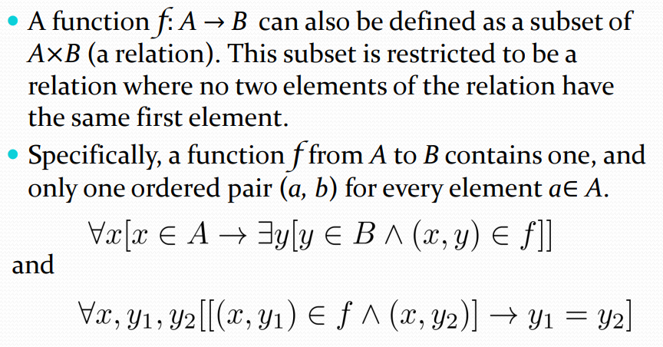
Functions
Relation VS Function
A = {1, 2} and B = {a, b, c}?
The Cartesian product A × B is;
A × B = {(1, a), (1, b), (1, c), (2, a), (2, b), (2, c)}.
FREE: For Complete Playlist: https://www.youtube.com/c/FahadHussaintutorial/playlists
For Code, Slide and Books: https://fahadhussaincs.blogspot.com/

Slide 24
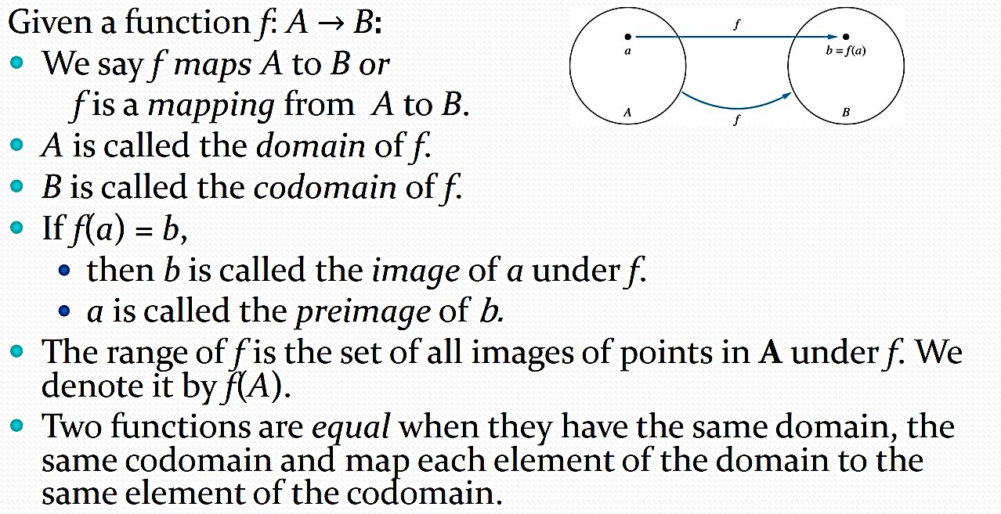
Functions
FREE: For Complete Playlist: https://www.youtube.com/c/FahadHussaintutorial/playlists
For Code, Slide and Books: https://fahadhussaincs.blogspot.com/

Slide 25
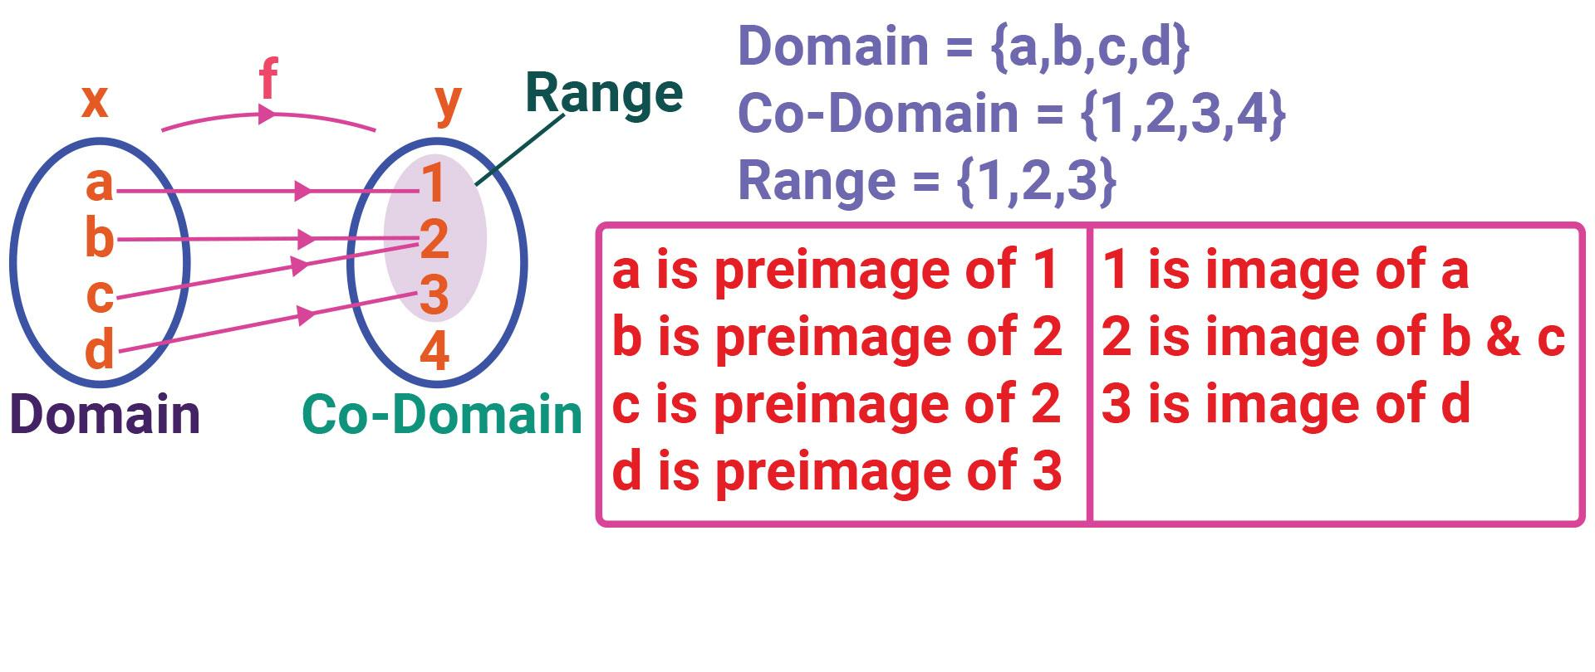
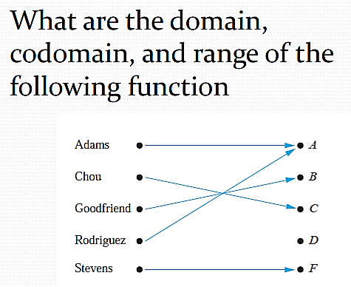
FREE: For Complete Playlist: https://www.youtube.com/c/FahadHussaintutorial/playlists
For Code, Slide and Books: https://fahadhussaincs.blogspot.com/

Slide 26
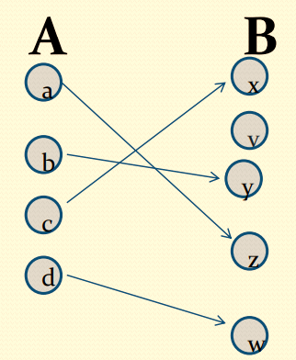
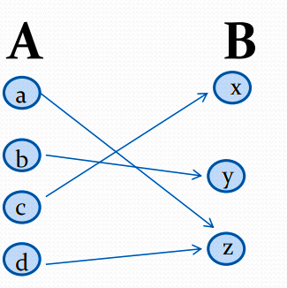
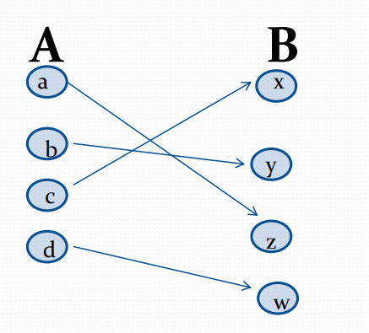
Types of Functions
Injections
Definition: A function f is said to be one-to-one , or
injective, if and only if f(a) = f(b) implies that a = b for
all a and b in the domain of f. A function is said to be
an injection if it is one-to-one.
Surjections
Definition: A function f from A to B is called onto or surjective, if and only if for every element there is an element with. A function f is called a surjection if it is onto.
Bijections
Definition: A function f is a one-to-one correspondence, or a bijection, if it is both one-to-one and onto (surjective and injective).
FREE: For Complete Playlist: https://www.youtube.com/c/FahadHussaintutorial/playlists
For Code, Slide and Books: https://fahadhussaincs.blogspot.com/

Slide 27
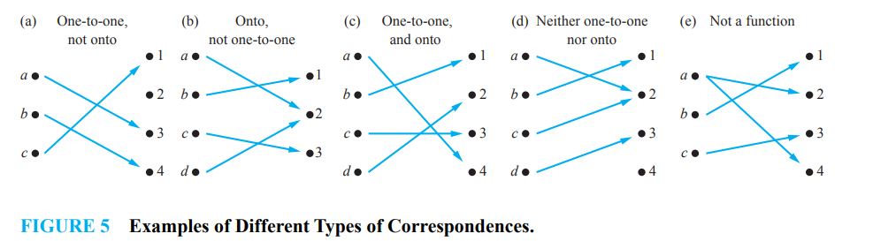
Is the function f (x) = x2 from the set of integers to the set of integers onto?
Solution: The function f is not onto because there is no integer x with x2 = −1, for instance
Is the function f (x) = x + 1 from the set of integers to the set of integers onto?
Solution: This function is onto, because for every integer y there is an integer x such that f (x) = y. To see this, note that f (x) = y if and only if x + 1 = y, which holds if and only if x = y − 1
Let f be the function from {a, b, c, d} to {1, 2, 3, 4} with f (a) = 4, f (b) = 2, f (c) = 1, and f (d) = 3. Is f a bijection?
Solution: The function f is one-to-one and onto. It is one-to-one because no two values in the domain are assigned the same function value. It is onto because all four elements of the codomain are images of elements in the domain. Hence, f is a bijection.
FREE: For Complete Playlist: https://www.youtube.com/c/FahadHussaintutorial/playlists
For Code, Slide and Books: https://fahadhussaincs.blogspot.com/

Slide 28
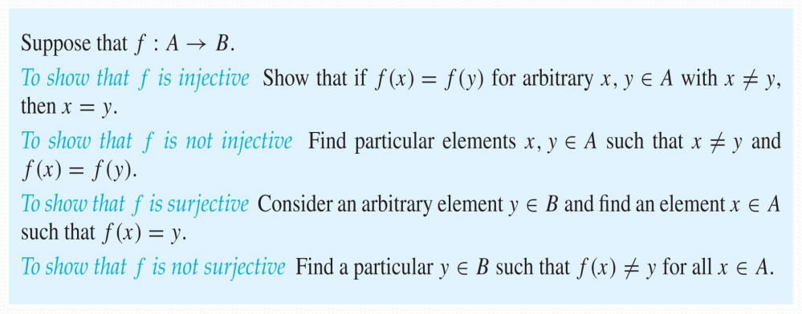
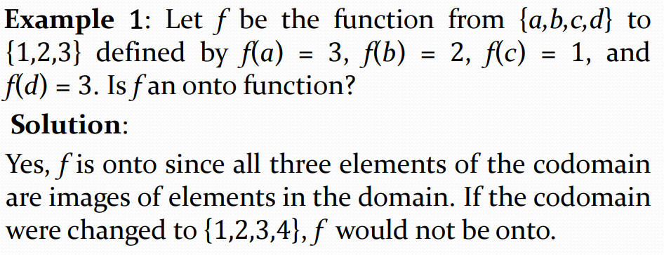
Showing that f is one-to-one or onto
FREE: For Complete Playlist: https://www.youtube.com/c/FahadHussaintutorial/playlists
For Code, Slide and Books: https://fahadhussaincs.blogspot.com/

Slide 29
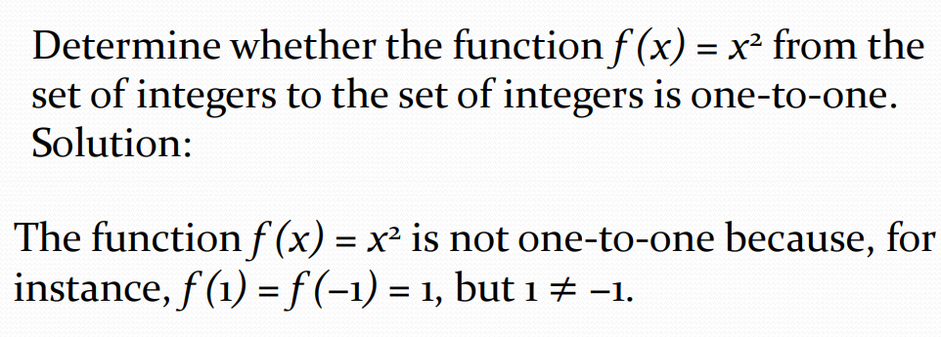
Showing that f is one-to-one or onto
FREE: For Complete Playlist: https://www.youtube.com/c/FahadHussaintutorial/playlists
For Code, Slide and Books: https://fahadhussaincs.blogspot.com/

Slide 30
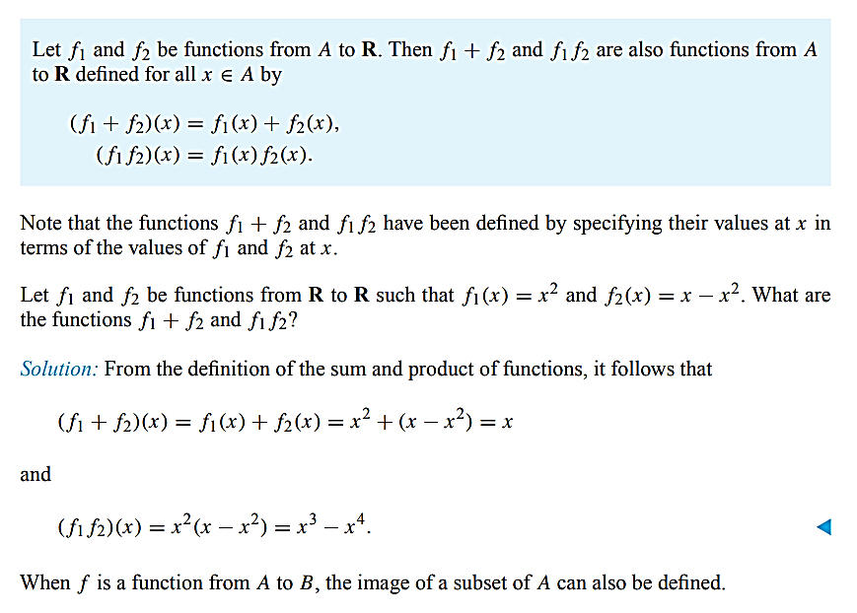
A function is called Real-Valued if its codomain is the set of real numbers, and it is called integer-valued if its codomain is the set of integers. Two real-valued functions or two integer valued functions with the same domain can be added, as well as multiplied.
FREE: For Complete Playlist: https://www.youtube.com/c/FahadHussaintutorial/playlists
For Code, Slide and Books: https://fahadhussaincs.blogspot.com/

Slide 31
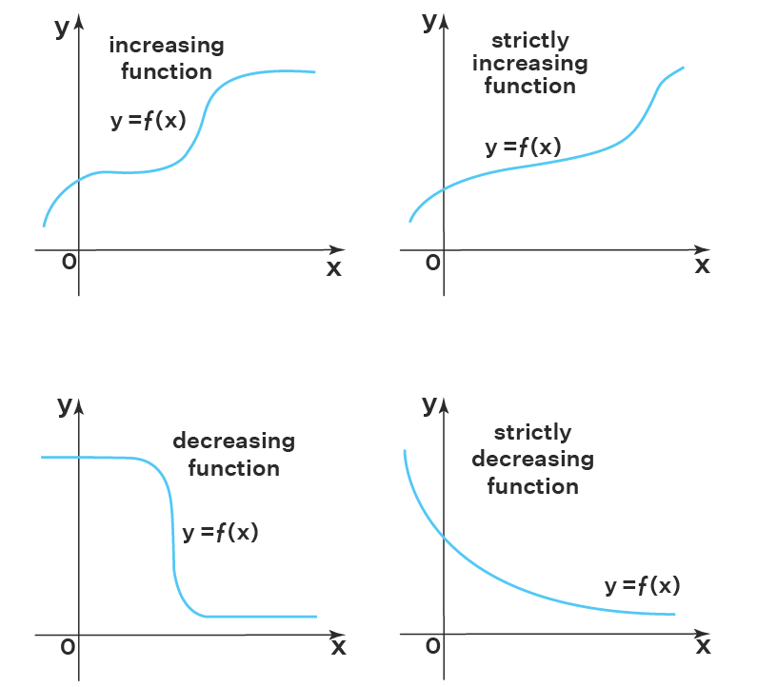
Increasing/ decreasing functions
FREE: For Complete Playlist: https://www.youtube.com/c/FahadHussaintutorial/playlists
For Code, Slide and Books: https://fahadhussaincs.blogspot.com/

Slide 32
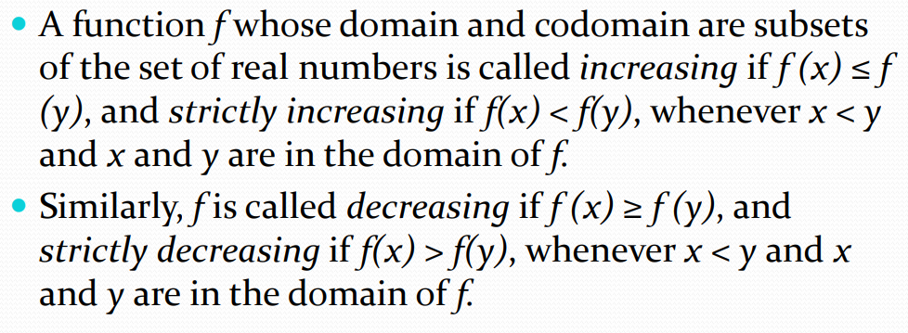
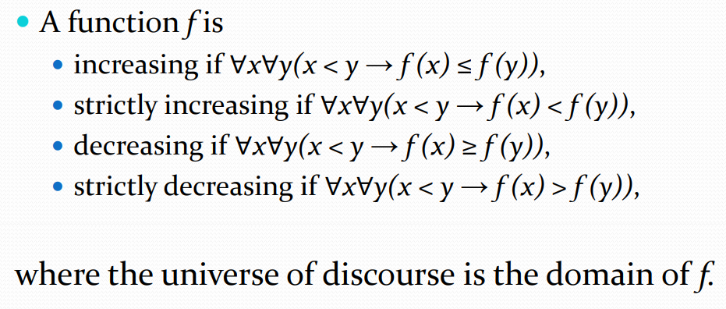
Increasing/ decreasing functions
FREE: For Complete Playlist: https://www.youtube.com/c/FahadHussaintutorial/playlists
For Code, Slide and Books: https://fahadhussaincs.blogspot.com/

Slide 33
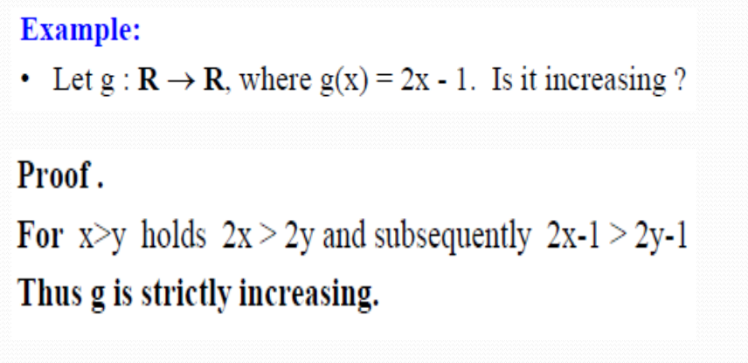
Increasing/ decreasing functions
FREE: For Complete Playlist: https://www.youtube.com/c/FahadHussaintutorial/playlists
For Code, Slide and Books: https://fahadhussaincs.blogspot.com/

Slide 34


FREE: For Complete Playlist: https://www.youtube.com/c/FahadHussaintutorial/playlists
For Code, Slide and Books: https://fahadhussaincs.blogspot.com/

Slide 35


Inverse Functions and Compositions of Functions

Slide 36

Inverse Functions and Compositions of Functions
FREE: For Complete Playlist: https://www.youtube.com/c/FahadHussaintutorial/playlists
For Code, Slide and Books: https://fahadhussaincs.blogspot.com/

Slide 37


Inverse Functions and Compositions of Functions

Slide 38


Inverse Functions and Compositions of Functions
FREE: For Complete Playlist: https://www.youtube.com/c/FahadHussaintutorial/playlists
For Code, Slide and Books: https://fahadhussaincs.blogspot.com/

Slide 39
Inverse Functions and Compositions of Functions
Example 0:
FREE: For Complete Playlist: https://www.youtube.com/c/FahadHussaintutorial/playlists
For Code, Slide and Books: https://fahadhussaincs.blogspot.com/

Slide 40


Inverse Functions and Compositions of Functions
FREE: For Complete Playlist: https://www.youtube.com/c/FahadHussaintutorial/playlists
For Code, Slide and Books: https://fahadhussaincs.blogspot.com/

Slide 41

Inverse Functions and Compositions of Functions
FREE: For Complete Playlist: https://www.youtube.com/c/FahadHussaintutorial/playlists
For Code, Slide and Books: https://fahadhussaincs.blogspot.com/

Slide 42


The Graphs of Functions
We can associate a set of pairs in A × B to each function from A to B. This set of pairs is called the graph of the function and is often displayed pictorially to aid in understanding the behavior of the function.
Let f be a function from the set A to the set B. The graph of the function f is the set of ordered pairs {(a, b) | a ∈ A and f (a) = b}.

Slide 43

The Graphs of Functions
Some Important Functions
FREE: For Complete Playlist: https://www.youtube.com/c/FahadHussaintutorial/playlists
For Code, Slide and Books: https://fahadhussaincs.blogspot.com/

Slide 44

The Graphs of Functions
Some Important Functions
FREE: For Complete Playlist: https://www.youtube.com/c/FahadHussaintutorial/playlists
For Code, Slide and Books: https://fahadhussaincs.blogspot.com/

Slide 45


The Graphs of Functions
Some Important Functions
FREE: For Complete Playlist: https://www.youtube.com/c/FahadHussaintutorial/playlists
For Code, Slide and Books: https://fahadhussaincs.blogspot.com/

Slide 46

The Graphs of Functions
Some Important Functions
FREE: For Complete Playlist: https://www.youtube.com/c/FahadHussaintutorial/playlists
For Code, Slide and Books: https://fahadhussaincs.blogspot.com/

Slide 47

More Functions
FREE: For Complete Playlist: https://www.youtube.com/c/FahadHussaintutorial/playlists
For Code, Slide and Books: https://fahadhussaincs.blogspot.com/

